Slide 1

SCDV 490: Delayed flights data
Noah, Jeremy, Kailey & Laia
Notes:
Noah

Slide 2
Introducing the data
United States Department of Transportation Website
Data from 2018 to 2024
140,875 rows, 21 columns
Important Columns: date, carrier, airport, delays (count and minutes), delay types (weather, late aircraft, security…)
Logistic Regression(Prediction) and Prophet Models(Forecasting) are built off these important columns
A delay occurs if the flight is delayed 15+ minutes
26 carriers
388 airports
Notes:
Laia

Slide 3
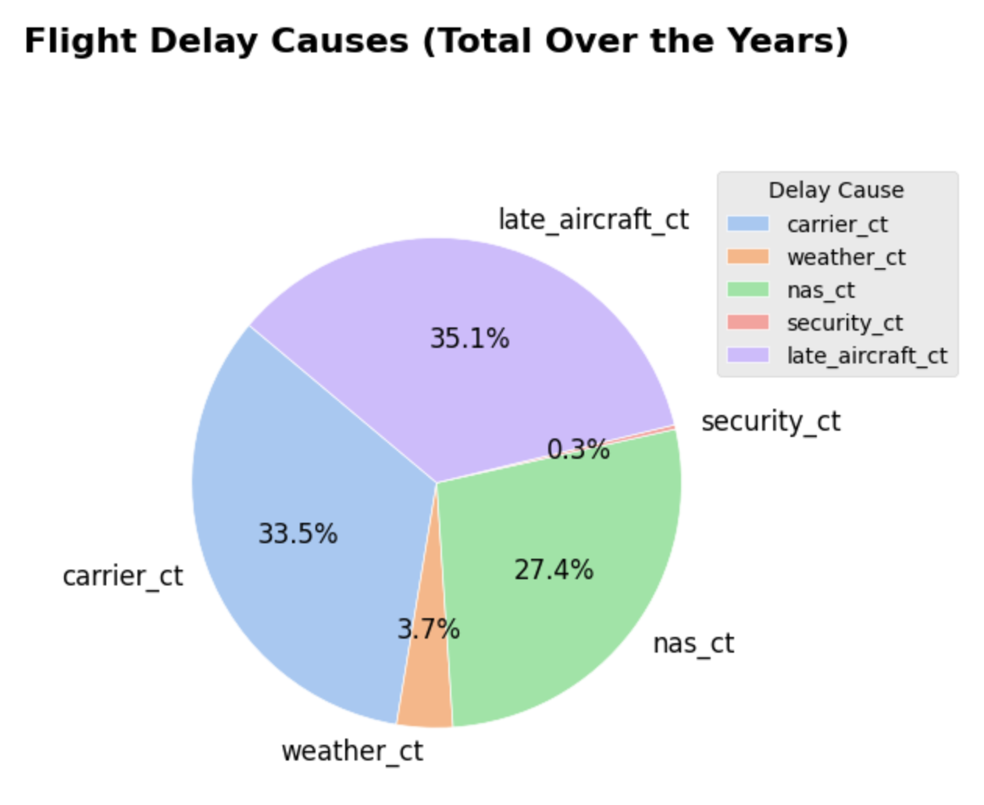
DELAY CAUSES
Carrier delay - Airline Related
Weather Delay - Hazardous Weather
National Aviation System Delay
Security Delay
Late Aircraft Delay
Notes:
Noah

Slide 4
Top 5 Worst Carriers
JetBlue Airways
Frontier Airlines
Spirit Airlines
American Airlines
Southwest Airlines
Restricting to top 50% carriers(14) by number of arrivals (>840,000 arrival flights) which is 90.7% of the total arrivals
Notes:
Laia

Slide 5
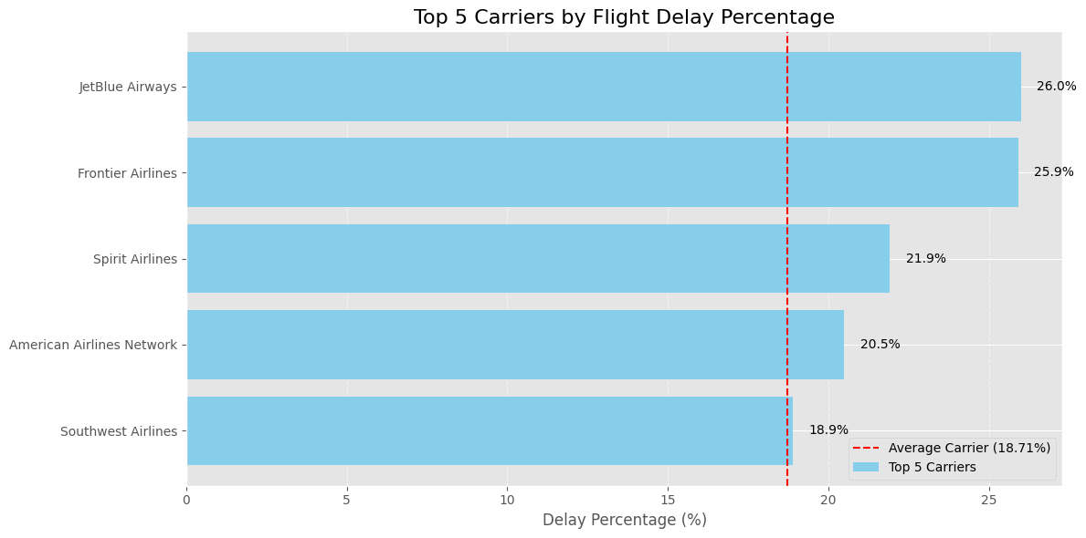
Notes:
Laia

Slide 6
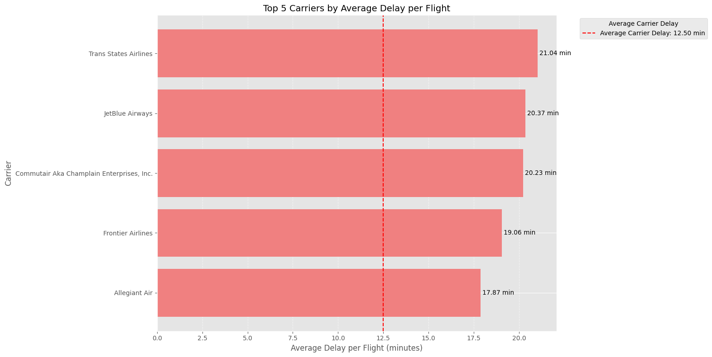
Notes:
Laia

Slide 7
Top 5 Worst Airports
San Juan, PR
West Palm Beach/Palm Beach, FL
Newark, NJ
Las Vegas, NV
Fort Lauderdale, FL
Restricting to top 20% airports(82) by number of arrivals (>90,000 arrival flights) which is 86.2% of the total arrivals
Notes:
Noah

Slide 8
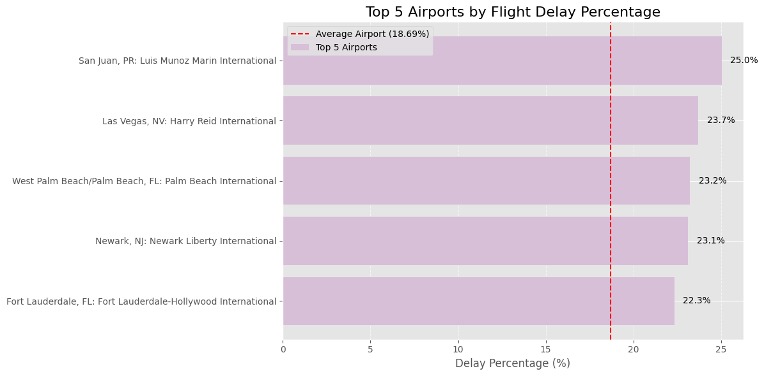
Notes:
Noah

Slide 9
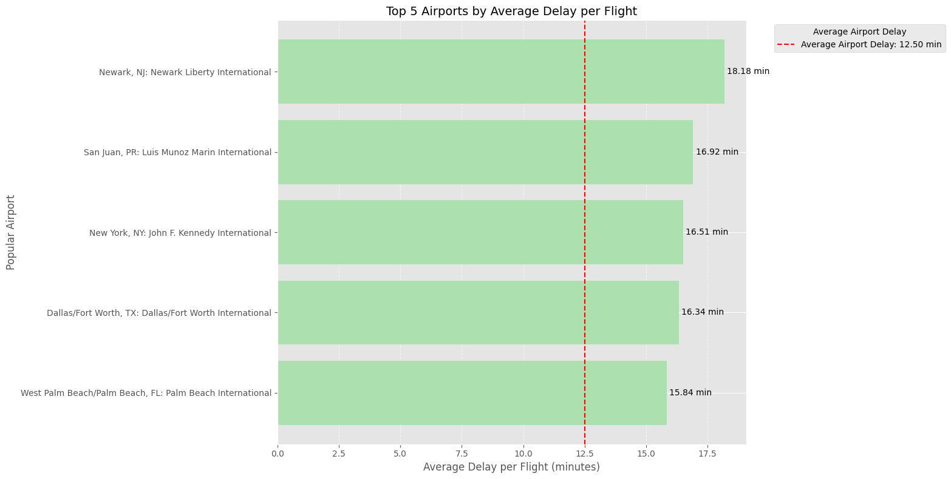
Notes:
Noah

Slide 10
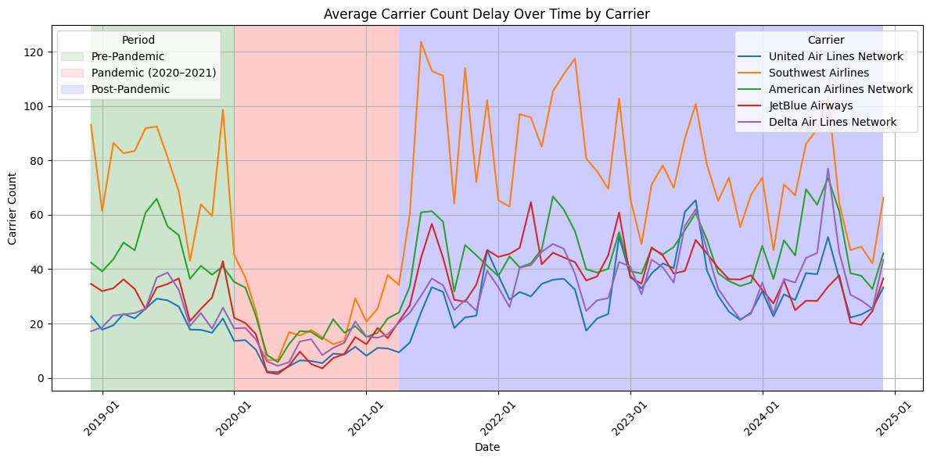
Model 1: Machine Learning Prediction
Carrier Delay Trends Over Time
How effectively can historical flight operational and scheduling data be utilized to predict carrier-related delays in airline performance?
2019 Baseline: Monthly delays steady across carriers
Pandemic Drop (2020–2021): Near-zero delays as flying paused
Post-Pandemic Surge: Counts rebound above 2019 levels, with strong summer & holiday spikes
Carrier Differences:
Southwest shows the largest peaks and volatility
Delta remains the most consistent
Seasonality Pattern: Predictable summer and year-end pressure points
Notes:
Speaker Notes
2019 Baseline “Before COVID, each airline averaged a stable range of monthly carrier delays—Southwest around 60–100, Delta around 15–25, with others in between. This gives us our ‘normal’ benchmark.”
Pandemic Drop “With travel virtually halted in early 2020, all carriers dropped to almost zero delays. This confirms that delays are tightly tied to flight volume and operational load.”
Post-Pandemic Surge “As flying resumed in mid-2021, delays not only returned but often exceeded their pre-pandemic peaks. This reflects the operational strain—crew shortages, gate congestion, and fleet repositioning as airlines scrambled to recover.”
Carrier Differences “Notice Southwest’s dramatic spikes—its high volume amplifies the effect of any disruption. Delta, by contrast, remains more stable, hinting at stronger operational resilience.”
Seasonality Pattern “Clear summer (June–Aug) and holiday (Nov–Dec) peaks appear consistently across all carriers. We’ll use these predictable pressure points in our model and in planning resource surges.”
How This Solves Our Problem
Informs Feature Engineering: We include “period” (pre/pandemic vs. post), month, and carrier as key inputs so the model captures these exact patterns.
Enables Proactive Staffing: By knowing when delays spike (summer, holidays, post-pandemic recovery), operations can pre-position crews, gates, and backup aircraft.
Guides Threshold Tuning: Observing carrier-specific volatility helps us set different alert thresholds for airlines like Southwest vs. Delta.
Supports Continuous Improvement: Tracking these trends over time lets us measure if process changes (new staffing models, schedule buffers) actually bring delays back in line with or below baseline.

Slide 11
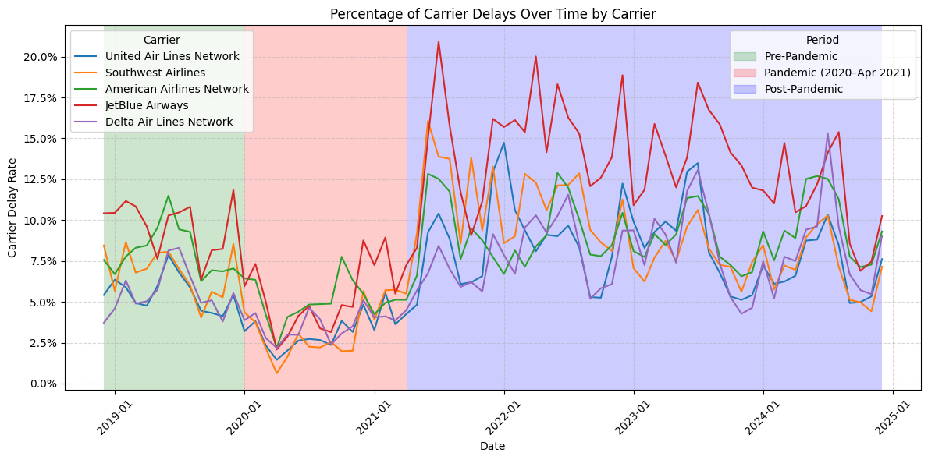
Model 1: Machine Learning Prediction
Carrier Delay Rate Trends & Insights
How effectively can historical flight operational and scheduling data be utilized to predict carrier-related delays in airline performance?
Pre-Pandemic (green): Stable delay rates around 5–10%
Pandemic (red): Rates drop to 1–3% as flying halts
Post-Pandemic (blue): Rates spike above 10–20%, with clear summer & holiday peaks
Carrier Comparison:
JetBlue shows the highest delay rates post-2021
Delta maintains the lowest and most consistent rates
Seasonality: Summer (Jun-Aug) and year-end (Nov-Dec) consistently worst
Notes:
Speaker Notes
Pre-Pandemic Baseline “From 2019, most carriers hovered in the 5–10% delay-rate range. This is our operational norm before COVID.”
Pandemic Shutdown “When travel collapsed in 2020, delay rates fell below 3%. This confirms that delay-rate is tightly linked to volume and operational stress.”
Post-Pandemic Surge “As flights rebounded in mid-2021, delay rates climbed above 10%—peaking over 20% for JetBlue. High demand plus staffing gaps drove this spike.”
Carrier Differences “Notice JetBlue’s volatility and sustained high rates versus Delta’s steady performance. These differences become key model inputs.”
Seasonal Peaks “We see repeat spikes every summer and holiday season—predictable pressure points for planning.”

Slide 12
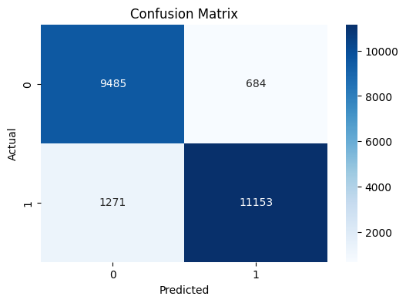
Model 1: Machine Learning Prediction
Logistic Regression Model: Predicting Carrier Related Delays
How effectively can historical flight operational and scheduling data be utilized to predict carrier-related delays in airline performance?
True Positives (TP): Flights we correctly predict will be delayed—enabling pre-emptive action.
True Negatives (TN): Flights we correctly predict will be on time—no wasted effort.
False Positives (FP): Flights we wrongly flag as delayed—may trigger unnecessary reallocations.
False Negatives (FN): Flights we miss—these delays slip through without warning.
≈ 42.0 % of all
≈ 93.2 % of on-time flights
≈ 3.0 % of all
≈ 6.8 % of on-time flights
On-Time
True Negatives
(Correctly left unflagged)
False Positives
(False alarms)
How This Model Solves the Problem:
Catch Real Delays: Flag nearly all actual delays so teams can prepare in advance.
Avoid False Alarms: Don’t waste crews or gates on flights that will run on time.
Balance Sensitivity: Tune the prediction threshold to match your comfort with missed delays vs. extra alerts.
Focus Resources: Direct staff and equipment to high-risk flights, leaving on-time flights to run smoothly.
≈ 5.6 % of all
≈ 10.2 % of delayed flights
≈ 49.4 % of all
≈ 89.8 % of delayed flights
Delayed
False Negatives
(Missed delays)
True Positives
(Correctly flagged)
Notes:
Slide Title & Context “On this slide we’re looking at our logistic regression’s confusion matrix alongside key takeaways on how it solves the carrier-delay problem. Recall our guiding question: How effectively can historical flight operational and scheduling data predict carrier-related delays?”
Walking Through the Confusion Matrix
True Negatives (TN = 9 485 / 93.2% of on-time flights) “These are flights that were on time and the model correctly left unflagged. In practical terms, we won’t waste crews or gates on flights that will run smoothly.”
False Positives (FP = 684 / 6.8% of on-time flights) “Here we see the ‘false alarms’—flights flagged as delayed but actually on time. While some extra effort is required, this is relatively small (under 7% of on-time flights).”
False Negatives (FN = 1 271 / 10.2% of delayed flights) “These are the delays we missed—about 1 270 flights (10% of all actual delays). These represent the biggest customer-experience risk, since there’s no warning.”
True Positives (TP = 11 153 / 89.8% of delayed flights) “Most importantly, we correctly flag nearly 90% of real delays. That gives operations teams ample time to react.”
How This Solves the Problem
Catch Real Delays “By correctly identifying almost 90% of delayed flights, we enable proactive measures—rerouting crews, staging backup aircraft, and notifying passengers well before departure.”
Avoid False Alarms “With only ~6.8% false positives, we minimize unnecessary resource allocation, keeping operations lean.”
Balance Sensitivity “We can tweak the decision threshold—if we want to reduce missed delays further, we can accept a few more false alarms, and vice versa.”
Focus Resources “Armed with a ranked list of high-risk flights (our true positives), ground and gate agents can prioritize their limited staff and equipment where it matters most, while trusting true negatives to proceed normally.”
Closing “This confusion matrix quantifies exactly where our model excels and where it can improve. It gives us a clear roadmap to fine-tune and deploy a delay-prediction system that shifts operations from reactive firefighting to data-driven, proactive planning.”

Slide 13
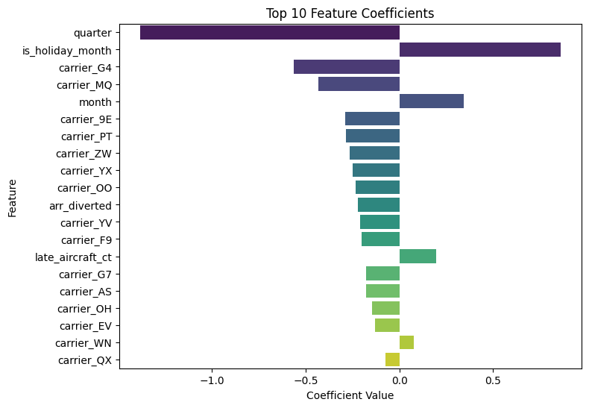
Model 1: Machine Learning Prediction
Logistic Regression Model: Key Drivers of Carrier Delays
How effectively can historical flight operational and scheduling data be utilized to predict carrier-related delays in airline performance?
Holiday Months (Nov/Dec) have the biggest jump in delay risk
Summer & Year-End Peaks (later months) boost delays
Off-Peak Quarters (Q1/Q4) see fewer delays
More Reliable Carriers (G4, MQ, 9E, PT, ZW, YX, OO) run below average delay rates
Upstream Disruptions (late aircraft, diversions) further increase delay odds
Notes:
Holiday Months “Notice that November and December carry the largest increase in delay risk. This aligns with our ‘holiday surge’ finding—higher passenger volumes, tighter crew schedules, and weather complications all converge to make this the most challenging period.”
Summer & Year-End Peaks “Beyond the holiday months, the model flags later calendar months (June through August, plus again in December) as higher-risk. These are our traditional high-demand travel windows where any small disruption can snowball.”
Off-Peak Quarters “In contrast, Q1 and Q4 show a negative effect on delay odds. With lighter schedules after the holidays and before summer, operations tend to run more smoothly and delays drop off.”
More Reliable Carriers “You’ll see a handful of carriers—G4, MQ, 9E, PT, ZW, YX, and OO—that consistently run below the average delay rate. These airlines are our ‘best performers’ in terms of on-time reliability.”
Upstream Disruptions “Finally, operational knock-on effects—like late-aircraft arrivals and diversions—also push delay probability up. That makes sense: a late incoming plane or diverted flight creates the very resource crunch that leads to further delays.”

Slide 14
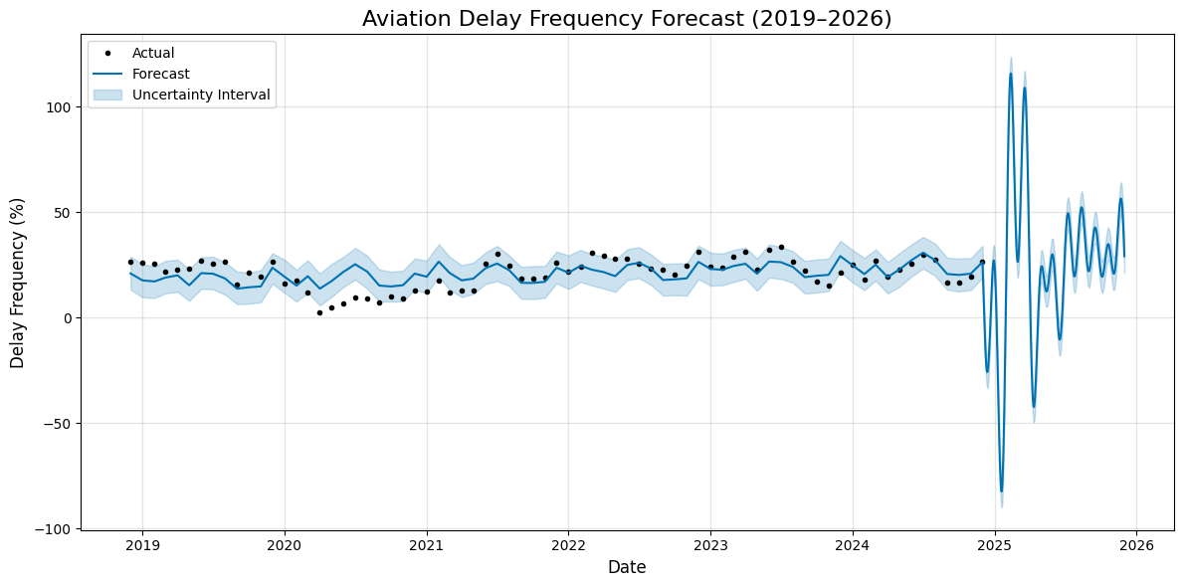
Model 2: Machine Learning Prediction
Prophet model: Additive Regression Model with Predictive Forecasting
How effectively can historical flight operational and scheduling data be utilized to predict airport-related delays in airline performance?
Notes:
Lines at start and end at 2020

Slide 15
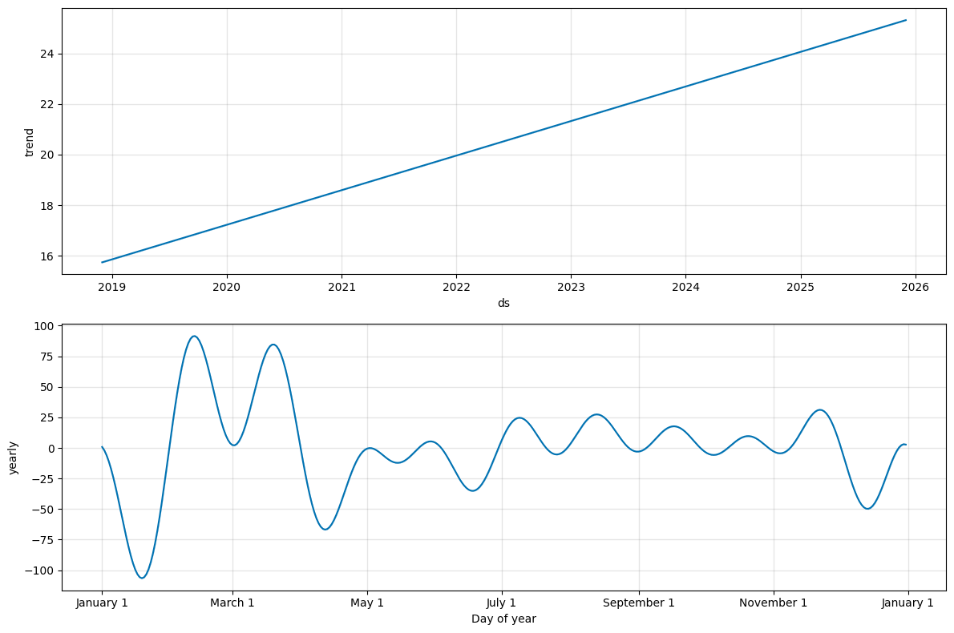
Model 2: Machine Learning Prediction
Prophet model: Additive Regression Model with Predictive Forecasting
How effectively can historical flight operational and scheduling data be utilized to predict airport-related delays in airline performance?
The top graph shows the delay frequency averages are consistently increasing over the years.
The second graph shows how delay frequency varies within each year, regardless of long-term trends. Again we see unreliability around the beginning of the year. Otherwise, there are peaks throughout the year.

Slide 16
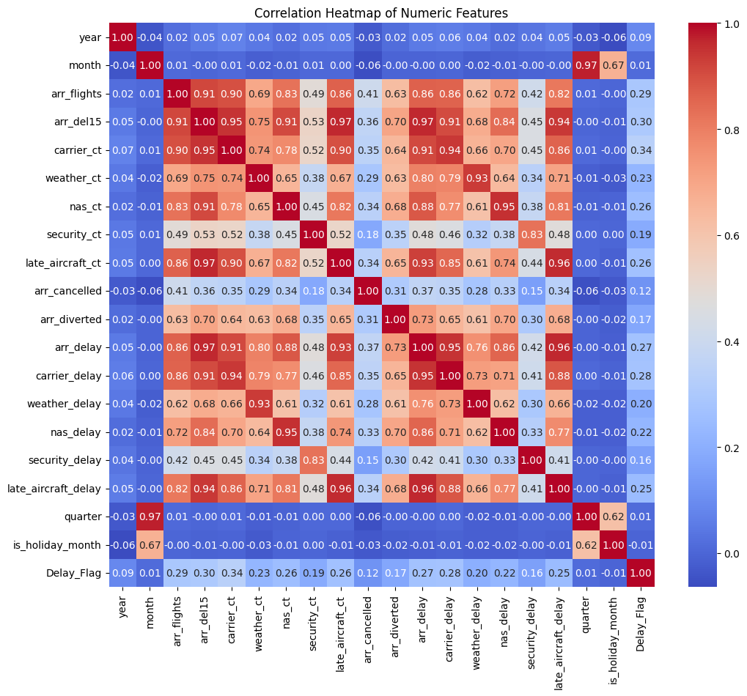
Model 2: Machine Learning Prediction
Logistic Regression Model: Predicting Carrier Related Delays
xx

